Slide 1
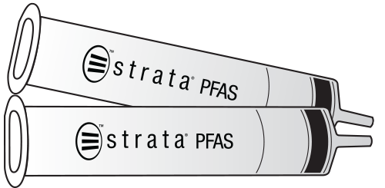
Improved Accuracy, Precision and Laboratory Productivity from Employing a Single Tube SPE-GCB Sample Preparation Configuration for the Analysis of PFAS under DOD QSM 5.3
Presented By Sam Lodge
Senior Business Development Manager - Environmental
August 5, 2021

Slide 2
BRIEF History of PFAS
Overview of Current Methodology
SPE requirements for EPA Methods (Drinking Water)
Non-DW matrices – DOD requirements
Future considerations
Conclusion
Notes:
This presentation will cover several areas, with only a minimal amount of time being spent on the History of PFAS and the various official methods (as these topics have been covered ad naseaum over the past 2+ years!). The majority of time will be spent reviewing the different sample prep strategies for compliance with DOD Table B15 from the QSM version 5.3. We will spend a few minutes discussing future considerations in PFAS analysis, especially the possible impact of the pending 1600 Series method on the sample prep options.

Slide 3
Accidental Chemicals
Viagra
Penicillin
Saccharin
Teflon
Notes:
We have all seen more PFAS presentations then we can count (and that is just this week only!) – but I think that this might be a new twist on the old PFAS back story. Turns out that PFAS (or in this case, specifically Teflon or PTFE) is one of several well known chemicals whose primary function was discovered by accident. Like Viagra (originally being considered as an treatment for male pattern baldness); Penicillin (who’s antibacterial properties were discovered when a bacterial plate was inadvertently exposed to mold); saccharine (my favorite – a food chemist forgot to wash his hands after playing in the lab all day, and discovered that they had a sweet residue) – PFAS compounds were originally used as refrigerants until an oversight in the lab allowed a container of gaseous PFAS spontaneously polymerized overnight, and the resulting waxy solid were discovered to have unique properties that could be used to create anti-stick surfaces, and provide stain resistance – as well as provide the ability to put out jet fuel fires.

Slide 4
Notes:
So what is it about PFAS compounds that make the such a big ENV concern? Firstly they are incredibly robust (C-F bonds are very strong, and difficult to break), and do not degrade under most normal environmental processes (requires oxidative combustion, which is not very scalable). Second, they are easily transferred within the ecosystem, both in air and water. Third, they have a long half life in vitro, between 2 and 9 years (less for the short chain compounds, and more for the longer chain) so can accumulate over time with repeated exposure, In addition, like many other pollutants these compounds can Biomagnify, or show increasing levels as they move up the food chain – and since people are Apex consumers it goes without saying that we would have the highest levels of PFAS contamination.

Slide 5
Negative Impact of PFAS
Toxicity???
Animal studies show possible health issues
Lack of any definitive data to link PFAS (esp. specific PFAS compounds)
Different PFAS have different effects (see Beluga whale study)
Short chain with shorter half life
Notes:
The missing piece (or one of the missing pieces – the other being the almost infinite number of potentiatl PFAS compounds) is that the Tox data is basically derived from animal studies, It does show some possible negative health outcomes from PFAS exposure, including cancer, compromised immune response, low birth weight and other developmental delays. There is lots of anecdotal data suggesting negative outcomes for humans (like cancer clusters and increased birth defects in areas with high PFAS levels

Slide 6
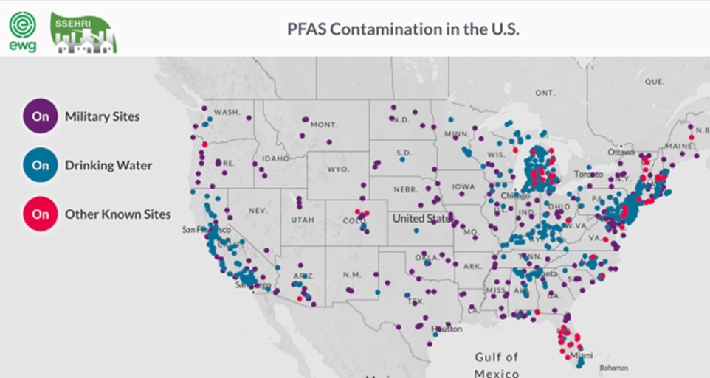
https://www.ewg.org/interactive-maps/pfas_contamination/
Notes:
PFAS contamination is found in DW systems serving 19 million people in the US
2337 sites in 49 states with PFAS levels. Levels of PFOA and PFOS are decreasing, but short chain (replacement) compounds are showing rising levels.
Number of contaminated sites will possibly increase as more targets are identified and have associated standards/isotopes, and as detection limits decrease with improving methodology and instrumentation

Slide 7
https://www.pennlive.com/news/2021/02/pa-american-water-sues-manufacturer-of-toxic-pfas-forever-chemicals.html
Notes:
And it is not just water – PFAS is found in deer and other animals that live in or near sites with high PFAS loads. It has been found in Polar Bears, as well as in Beluga whales (which is interesting in that there seem to be differences in the types of PFAS found in animals based on age and sex – suggesting that different organisms can carry heavier PFAS concentrations of specific cmpds then other organisms.

Slide 8
History of PFAS Analytical methodology
EPA 537 (2009)
EPA 8327 (2015) - 2021
EPA 537.1 (2018)
EPA 533 (2020)
DOD QSM (2019 for Ver. 5.3) – NOT A METHOD!
No official/promulgated methods for non-DW matrices (NOT TRUE AS OF LAST WEEK!)
Notes:
There are several official/persrciptive methods for PFAS analysis, but as of today they are only valid for DW. The first official PFAS analytical method was EPA 537 for 14 compounds, promulgated in 2009, and part of UCMR3 study. It was updated to 537.1 In 2018 with the addition of 4 new compounds, including ADONA, which serves as a replacement for PFOS and PFOA – both being phased out of production in the early 2000’s. EPA 533 was published in 2020, and included 25 PFAS compounds – 14 from 537.1, and 11 short chain and additional replacement compounds, including several FTS which can convert to PFAS (TOP assays measure this conversion under oxidative combustion)
EPA 8327 (similar to ASTM 7979) was developed as a method for NonDW matrices. It is a DAI method, with no SPE to remove interferences or concentrate the sample. Easier to run but requires very high end MS with high levels of sensititvity However, it has not been promulgated and DOD has gone on record as limiting this to screening rather then a quant method.
DOD Quality Systems Manual v. 5.3 is not a method, but rather is a series of quality guidelines that are incorporated into existing methodology to ensure that data on DOD site analysis is comparative as apples to apples. It has similar requirements of ID and SPE as 533

Slide 9
History of PFAS Analytical methodology
EPA 537 (Polymer SPE)
EPA 537.1 (SDVB SPE only)
ASTM D7979/EPA 8327 (DAI)
EPA 533 (WAX SPE)
DOD (WAX + GCB)
No official/promulgated methods for non-DW matrices
Notes:
As this presentation is focused on SPE, it is worthwhile to note the evolution of sample prep over the many PFAS methods. 537 called for a SDBL, but as it indicated or equivalent, SPE manufacturers promoted newer co-polymers of SDBL for this method. 537,1 closed that loophole by specifying that only SDBL cartiridges were allowed (no co-polymers).
As previously discussed, 8327 and ASTM 7979 are both DAI methods, with no SPE required.
537 and 537.1 both included only the longer chain PFAS compounds, as the SDBL SPE sorbent (utilizing Hydrophobic interactions between sorbent and analytes) was not effective for shorter SA and CA compounds. These PFAS analytes are more amenable to using WAX media to IEX with these acidic compounds.
DOD QSM 5,3 calls for SPE but does not specifiy WAX – however, as this is more appropriate for extended panels, and is more selective for PFAS (compared to matrix interferences) most methods for DOD cert use the WAX media This biggest difference with the Table B15 guidelines is the requirement to use GCB for post extraction clean up of the sample.

Slide 10
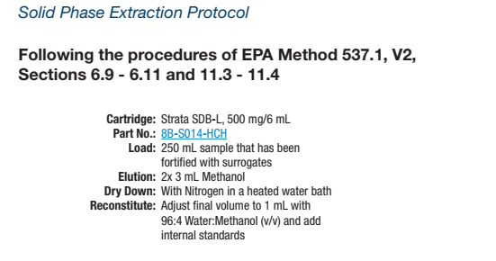
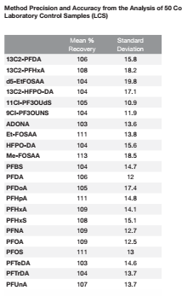
Special thanks to Agustin Pierri and Weck Labs for providing this data
Notes:
Here is an example of a 537.1 sample extracted with Strata- SDBVB showing high recoveries for all 18 compounds. RSD’s are high, but this is possibly due to weak interaction of the acids on the SDVB media

Slide 11
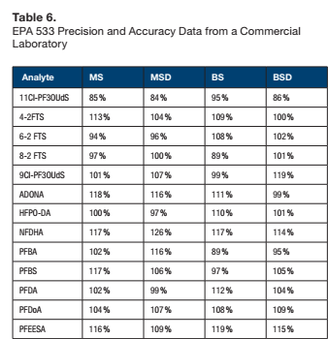
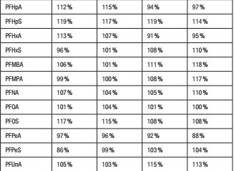
Special thanks to Agustin Pierri and Weck Labs for providing this data
Notes:
Here is an example of a 25 analyte 533 panel extracted using Strata X-AW. No RSD values are included, but a quick review shows that the recoveries are very

Slide 12
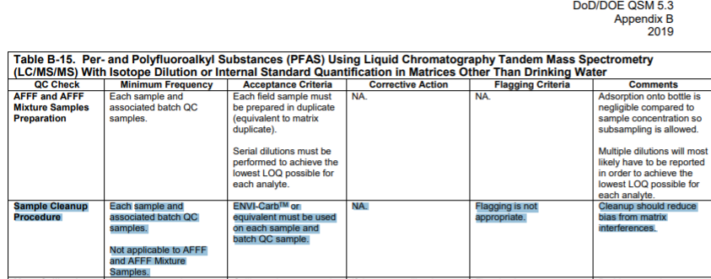
Notes:
Table B-15 from the QSM V5.3 has a requirement to use Env-Carb for post extraction clean up of non-DW samples. However, they indicate equivlenat media can be used (GCB), and they do not indicate format

Slide 13
GCB in PFAS sample prep
Only for non-DW matrices
Removes Organic Acids that can suppress ionization (TDCA and PFOS)
Table B-15 provides for equivalent to Envi CarbTM
Can actually improve recovery of long chain/neutral compounds (depends on format)
Potential loss of analytes unless GCB is re-extracted
Several ways to skin a cat!
Notes:
The back story of using GCB is that there are organic interferences in samples that have significant exposure to Biota (including sediments, soils, Waste water and Biosolids). These compounds are mostly organic acids (like Humic or Cholic Acid) that are co-extracted with the acidic PFAS compounds. These organic acids can be removed by GCB, but there is evidence to suggest that long chain PFAS compounds will also interact with the GCB, resulting in lower recoveries for these compds. However this same interaction can actually improve recovery of the same long chain compounds, depending on the format used

Slide 14
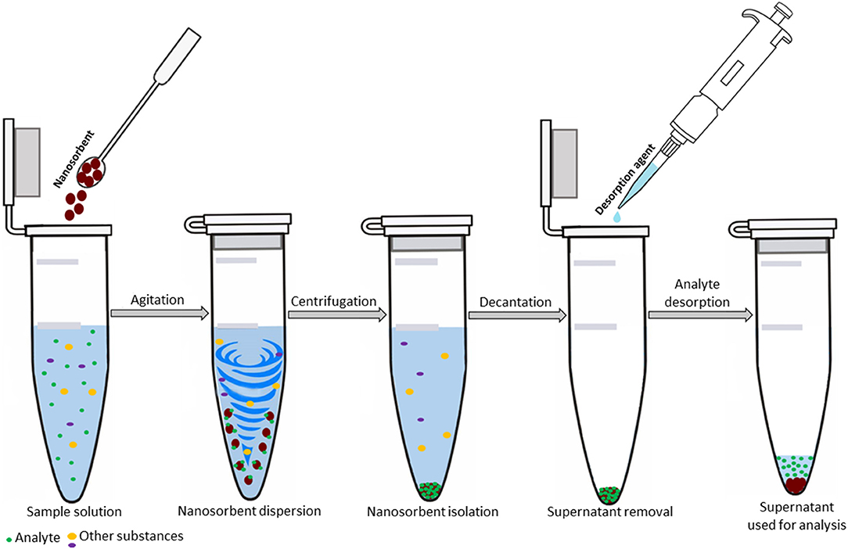
GCB for QSM 5.3, Table B-15
dSPE with Loose GCB (10mg-100mg)
Notes:
Most labs introduced GCB into their methods using bulk media for dSPE. This involves adding an aliqiot of GCB to the extracted sample, vortexing this mixture, and then spinning it down to allow for the supernatant to be drawn off and injected into the LC

Slide 15
Downside of dSPE
Time – additional 45-60 minutes per batch of samples
Precision – more sample manipulation = more variability
Messy – Loose GCB requires use of PPE and ventilation
Recovery – potential loss of long chain compounds (unless re-extract the GCB)
Potential clogging of LC or MS from contamination with GCB from extract
Notes:
There are several issues with using dSPE for this cleanup, including: Time
Precision
Mess
Recovery
Clogging

Slide 16
Special thanks to Eurofins Lancaster Labs for providing this data
Notes:
This data is from a study performed at Eurofins Lancaster, the largest PFAS lab in the US. They determined that dSPE led to significantly lower recoveries of long chain compounds (possibly from the retention of these compounds on the GCB – which could be addressed by re-extracting the GCB after the centrifgiation (but of course that is additional steps and additional time and potential variability)

Slide 17
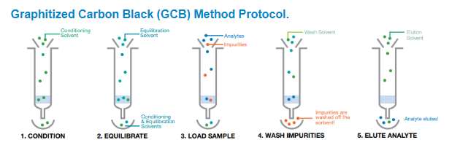
Downside of separate GCB tubes
Additional Time – approximately 15 minutes per batch of samples
Cost – solvent and tube ($5-7 per sample)
Notes:
Due to the limitations and problems associated with dSPE most labs moved over to separate (stand-alone) GCB tubes for the cleanup. In this case the SPE eluent was then passed through the separate GCB cartridge. Benefits were less mess (GCB already contained), less variability (fewer steps, and the GCB is already pre-measured and QCd), no potential for clogging the LC/MS. However there are still additional time and $ using this format.

Slide 18
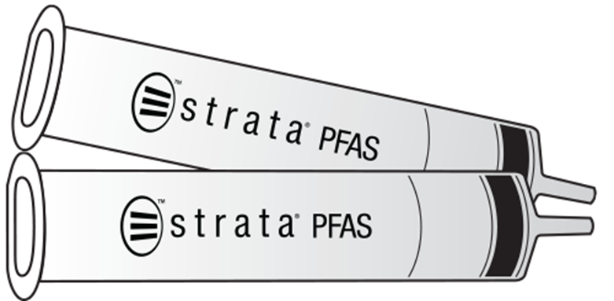
Incorporate WAX and GCB in a single SPE tube!
200mg WAX/50mg GCB
500mg WAX/50mg GCB
Notes:
Our solution (actually developed in collaboration with Eurofins Lancaster is to incorporate the GCB within the WAX SPE tube, creating a stacked tube. After exhaustive experimentation the 200mg WAX/50mg GCB and 500mg WAX/50mg GCB formats were determined to offer the best recoveries and lowest RSD values for these methods

Slide 19
 | dSPE |  |  | Stacked Tubes CS0-9207
Analyte | Spk Conc. (ng/L) | % Rec | RSD | Spk Conc. (ng/L) | % Rec | RSD
10:2 FTS | 50.00 | 80% | 6.2% | 20.00 | 94% | 11.5%
11Cl-PF3OUdS | 50.00 | 85% | 23.6% | 20.00 | 93% | 7.0%
3:3 FTCA | 50.00 | 89% | 11.6% | 20.00 | 86% | 4.2%
4:2 FTS | 50.00 | 100% | 2.9% | 20.00 | 103% | 2.9%
5:3 FTCA | 50.00 | 86% | 0.6% | 20.00 | 94% | 3.0%
6:2 FTS | 50.00 | 98% | 5.0% | 20.00 | 109% | 4.5%
7:3 FTCA | 50.00 | 79% | 12.6% | 20.00 | 90% | 5.3%
8:2 FTS | 50.00 | 97% | 5.8% | 20.00 | 105% | 3.4%
9Cl-PF3ONS | 50.00 | 94% | 18.6% | 20.00 | 95% | 5.9%
ADONA | 50.00 | 99% | 3.2% | 20.00 | 100% | 3.4%
EtFOSA | 50.00 | 109% | 9.6% | 20.00 | 104% | 11.3%
EtFOSE | 50.00 | 92% | 11.8% | 20.00 | 92% | 7.1%
HFPO-DA | 50.00 | 110% | 6.9% | 20.00 | 102% | 9.9%
MeFOSA | 50.00 | 108% | 6.6% | 20.00 | 102% | 16.7%
MeFOSE | 50.00 | 93% | 11.2% | 20.00 | 109% | 8.4%
N-EtFOSAA | 50.00 | 96% | 6.1% | 20.00 | 101% | 11.2%
N-MeFOSAA | 50.00 | 103% | 9.7% | 20.00 | 99% | 12.1%
PFBA | 50.00 | 96% | 1.4% | 20.00 | 96% | 0.6%
PFBS | 50.00 | 97% | 3.2% | 20.00 | 98% | 4.7%
PFDA | 50.00 | 101% | 4.3% | 20.00 | 97% | 6.1%
PFDoDA | 50.00 | 100% | 1.7% | 20.00 | 98% | 3.6%
PFDS | 50.00 | 85% | 21.5% | 20.00 | 96% | 6.9%
PFHpA | 50.00 | 99% | 2.8% | 20.00 | 97% | 3.2%
PFHpS | 50.00 | 102% | 1.9% | 20.00 | 92% | 6.1%
PFHxA | 50.00 | 96% | 2.3% | 20.00 | 100% | 5.4%
PFHxDA | 50.00 | 73% | 15.6% | 20.00 | 97% | 1.0%
PFHxS | 50.00 | 97% | 0.8% | 20.00 | 95% | 7.3%
PFNS | 50.00 | 97% | 10.5% | 20.00 | 95% | 3.7%
PFOA | 50.00 | 106% | 8.0% | 20.00 | 101% | 3.8%
PFOcDA | 50.00 | 32% | 23.8% | 20.00 | 87% | 2.5%
PFOS | 50.00 | 96% | 12.5% | 20.00 | 98% | 5.0%
PFPeA | 50.00 | 96% | 3.6% | 20.00 | 98% | 4.0%
PFPeS | 50.00 | 95% | 4.2% | 20.00 | 95% | 5.7%
PFTeDA | 50.00 | 100% | 2.6% | 20.00 | 100% | 4.2%
PFTrDA | 50.00 | 96% | 12.5% | 20.00 | 94% | 2.2%
PFUndA | 50.00 | 104% | 5.9% | 20.00 | 97% | 0.8%
Average |  | 94% | 8% |  | 98% | 6%
Notes:
A comparison of results of LCS samples using dSPE and Stacked Tubes is shown here, While dSPE showed acceptable results (all recoveries were 70-130, and RSD’s <30%) data from the stacked tubes show improvements in both areas – higher recoveries and lower RSD. It is worthwhile to note that the dSPE samples were spiked at 50ng, while the Stacked Tube samples were spiked at 20ng (meaning that the lower RSD’s for the stacked tubes are even more advantageous relative to the RSD’s for the dSPE samples.

Slide 20
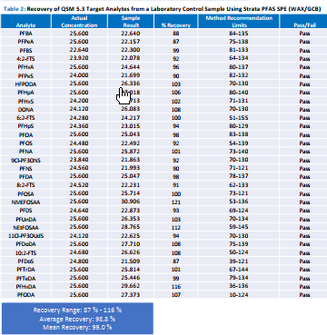
Special thanks to Eurofins Lancaster Labs for providing this data
Notes:
THis shows the recoveries from an expanded panel of PFAS using the 200mg/50mg stacked tubes – all analytes met recovery limits using a LCS spike.

Slide 21
Percent Recoveries of a 2ng/L for Matrix Spikes (MS) and Matrix Spike Duplicates (MSD) of PFAS compounds spikes in a wastewater Discharge pond, Stormwater Runoff and Two Wastewater effluents.
 | WW Effluent 1 |  | WW Discharge Pond |  | Stormwater Runoff |  | WW Effluent 2
 | MS | MSD | MS | MSD | MS | MSD | MS | MSD
N-EtFOSAA | 94% | 92% | 86% | 92% | 109% | 114% | 118% | 123%
N-MeFOSAA | 112% | 115% | 100% | 117% | 112% | 115% | 120% | 136%
PFBSª | 209% | 219% | 239% | 218% | 162% | 182% | 2040% | 2003%
PFBS^{b} | - | - | - | - | - | - | 111% | 106%
PFBA | 104% | 79% | 123% | 123% | 103% | 113% | 108% | 114%
PFPeA | 107% | 70% | 133% | 139% | 106% | 119% | 114% | 115%
PFHxA | 125% | 76% | 166% | 163% | 102% | 103% | 111% | 119%
PFHpA | 107% | 82% | 106% | 107% | 93% | 114% | 122% | 112%
PFHxS | 103% | 96% | 145% | 160% | 117% | 88% | 112% | 101%
PFOA | 96% | 71% | 121% | 114% | 93% | 113% | 126% | 117%
PFNS | 99% | 94% | 104% | 87% | 102% | 96% | 105% | 110%
PFNA | 109% | 94% | 102% | 108% | 96% | 102% | 109% | 114%
PFDA | 113% | 85% | 104% | 110% | 99% | 95% | 117% | 125%
PFUnDA | 110% | 90% | 97% | 95% | 109% | 114% | 113% | 114%
PFDoDA | 117% | 92% | 83% | 88% | 114% | 110% | 119% | 123%
PFOS | 105% | 88% | 110% | 114% | 129% | 133% | 102% | 106%
PFTrDA | 104% | 83% | 71% | 74% | 89% | 88% | 95% | 96%
PFPeS | 93% | 86% | 78% | 92% | 82% | 86% | 94% | 97%
PFTeDA | 107% | 94% | 67% | 67% | 116% | 108% | 118% | 127%
PFHxDA | 104% | 110% | 54% | 56% | 100% | 103% | 116% | 125%
PFOcDA | 90% | 101% | 54% | 55% | 65% | 63% | 92% | 105%
5:3-FTCA | 114% | 76% | 126% | 134% | 91% | 93% | 107% | 124%
7:3-FTCA | 122% | 77% | 131% | 144% | 102% | 98% | 107% | 106%
HFPO-DA | 109% | 80% | 104% | 99% | 87% | 101% | 115% | 86%
DONA | 105% | 93% | 90% | 106% | 85% | 86% | 92% | 95%
9Cl-PF3ONS | 83% | 77% | 92% | 94% | 107% | 100% | 103% | 102%
11Cl-PF3OUdS | 70% | 66% | 55% | 51% | 92% | 90% | 95% | 91%
EtFOSE | 102% | 100% | 92% | 72% | 120% | 102% | 142% | 161%
MeFOSE | 86% | 106% | 64% | 83% | 124% | 102% | 130% | 118%
EtFOSA | 96% | 100% | 54% | 61% | 112% | 105% | 113% | 124%
MeFOSA | 100% | 97% | 67% | 72% | 110% | 112% | 137% | 146%
PFOSA | 127% | 95% | 116% | 101% | 120% | 110% | 120% | 114%
4:2-FTS | 117% | 84% | 109% | 118% | 98% | 102% | 112% | 109%
PFHpS | 106% | 91% | 68% | 115% | 101% | 98% | 102% | 111%
PFDS | 82% | 86% | 51% | 69% | 95% | 83% | 96% | 96%
8:2-FTS | 119% | 93% | 109% | 111% | 107% | 104% | 114% | 111%
6:2-FTS | 114% | 97% | 106% | 134% | 129% | 104% | 128% | 107%
10:2-FTS | 107% | 105% | 70% | 69% | 47% | 54% | 80% | 87%
3:3-FTCA | 101% | 94% | 84% | 83% | 83% | 71% | 23% | 54%
PFEESA | 108% | 120% | 97% | 95% | 98% | 112% | 111% | 106%
PFMPA | 121% | 126% | 102% | 116% | 132% | 129% | 134% | 133%
PFMBA | 117% | 103% | 107% | 116% | 114% | 112% | 125% | 123%
NFDHA | 111% | 111% | 96% | 108% | 104% | 103% | 117% | 120%
Special thanks to David Scheissel and Babcock Labs for providing this data
Notes:
Stacked tubes show good performance on real world samples (MS and MSD’s of Wastewater and Runoff). While there are certainly some matrix effects (note the recoveries for PFBS and PFBA) overall these tubes showed excellent results

Slide 22
BENEFITS OF STACKED TUBES
High recoveries that meet DOD requirements
No need for PPE (N95 Masks or hoods)
Lower cost of solvents and consumables
Less sample manipulation
Consistent formats for reduced variability
Single step extraction and cleanup to save time and reduce costs
Notes:
To summarize – SPE with stacked tubes containing WAX media on top of GCB media meet the DOD requeirements for non-DW cleanup, and meet all Qcguidelines as outlined in Table B-15. The recoveries and RSD’s are well within limits, and are as good if not better then results obtainded by using dSPE. It is a simpler (one tube), faster (no aliquoting/vortexing/centrifuging) and less costly (consumables and manpower) way of meeting DOD compliance

Slide 23
Future considerations
UCMR5
GCB Pass Through (50mg or 25mg)
On-line SPE (Including On-line GCB cartridges)
Unique SPE formats for dirty matrices (soil, sediment, biota)
Extended panels and resolution issues – Unique LC chemistry and MP needed to improve resolution of more analytes
TOP and TOF assays for fingerprinting source and showing transport mechanisms
Non-targeted assays
Pending 1600 Series method to replace Table B15
Notes:
Of course this is not the final step improving PFAS methodology. PFAS contamination will remain a significant problem, at least until a robust, scalable and cost effective means of remediating this contamination is developed.
Other areas that are being investigated include unique formats for introducing GCB, especially for very dirty matrices. GCB Pass Through cartridges (similar to a syringe filter, but with 25-50mg of GCB) would allow for more comprehensive cleanup, and online SPE (including On-lne GCB would increase productivity. Unique SPE formats that incorporate some degree of filtration would also help with very dirty samples. As more PFAS compounds are identified (and standards are developed), it is certain that LC resolution wil become more critical, so unique LC chemistries as well as different MP conditions (including uses of different modifiers and pH levels) will be needed to allow for accurate quantification. More work is being done on source determination and transport mechanisms, so TOF and TOP assays are begin developed to help “Fingerprint” different PFAS originations (there is also some work on chiral separations to determine ratios of linear and branched species, which might also be used as an identifier for PFAS sources. More Non-targeted work (in conjunction with TOP and TOF) will expand our knowledge of the PFAS universe.
Lastly, the pending 1600 series method currently restricts labs to using dSPE, so there is a lot of work currently being done to qualify other GCB formats as equivalent for the QC guidelines for this pending method (awaiting multi-lab validation)

Slide 24
Conclusion
PFAS are not going away – and we have just scratched the surface
Lots of different ways to analyze PFAS – depending on matrix and analyte list
Stacked Tubes offer performance and productivity benefits for DOD compliant work
Phenomenex SPE products are demonstrated Fit for Purpose for all published methods
New formats and chemistries being considered
https://www.phenomenex.com/Info/Page/pfasresources
Notes:
To summarize – PFAS analysis is a moving target. Thousands of possible compounds and we have just scratched the surface in our knowledge of transport, degradation/remediation and harmful effects. As the number of compounds being studied increases (and as more work is being done in complex matrices like soils/sediments/biota) the need for more selective and robust sample prep methods becomes even more important. PHX SPE Products have been demonstrated as Fit for Purpose for all published methods, to date, Novel SPE formats like Stacked Tubes offer both performance and productivity benefits in these areas, and extensive work will continue in developing new technologies to support this work. Additional information is available at our PFAS Resource web page.

Slide 25
Special thanks to the following labs and individuals for their invaluable assistance:
Agustin Pierri at Weck Labs
David Scheissel at ES Babcock
Andrew Patterson and Bob Brown at Eurofins Lancaster Labs

Slide 26
Questions?

