Slide 1
Per- and Polyfluoroalkyl Substances (PFAS) Contamination in Materials Used to Collect, Prepare, and Analyze for PFAS in the Environment
Danielle Kleinmaier, Lawrence Zintek
U.S. Environmental Protection Agency
Region 5 Laboratory

Slide 2
Disclaimer
Reference herein to any specific commercial product, process, or service by trade name, trademark, manufacturer, or otherwise does not constitute or imply its endorsement, recommendation, or favoring by the United States government.
The views and opinions of the authors expressed herein do not necessarily state or reflect those of the United States government or the United States Environmental Protection Agency and shall not be used for advertising or product endorsement purposes.

Slide 3
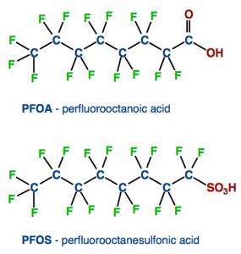
Background
PFAS are commonly observed, persistent, and appear to be resistant to many treatment processes (“forever chemicals”)
Compounds manufactured to make products more resistant to stains, grease, and water
Found in many products:
Foams used for fire suppression
Non-stick cookware
Waterproof and stain-resistant textiles
Water and oil resistant papers
Metal plating and etching fluids

Slide 4
Historically Common Contamination Sources in the Field or Lab
PTFE- or FEP-containing products (e.g. Teflon®)
PVDF- or ETFE-containing products (e.g. certain kinds of tubing)
Waterproof, water-resistant, or stain-resistant clothing/products (e.g. outdoor wear, lab coats, fast food wrappers)
Certain personal care products (e.g. cosmetics, lotions)
Certain insect repellants and sunscreens
Plastic clipboards, binders, or hardcover spiral books
Post-it® notes
Recycled paper products (e.g. paper towels, notebook paper)
Chemical (blue) ice packs
Disposable glass pipettes
Aluminum foil
Kim® wipes
Latex gloves

Slide 5
ASTM Standards D7979 and D7968
Developed at Region 5 lab for non-drinking water and solid matrices
~3,000 field samples analyzed since 2012 (+ ~2,800 QC samples)
Direct injection methods (i.e. “dilute and shoot”)
Minimal sample manipulation reduces prep time, minimizes risk of blank contamination
External standard methods
Labelled surrogates for most target analytes, used strictly to evaluate method performance
Analysis by LC/MS/MS
Confirmatory transitions for most target analytes
Ion ratios calculated to support qualitative IDs

Slide 6
Current Region 5 Lab PFAS Analyte List
Target Analyte | Reporting Limit in Water (ng/L) | Reporting Limit In Soil (ng/kg) | Labelled Surrogate
PFBA, PFPeA | 50 | 125 | x
PFBS | 10 | 25 | x
PFPeS | 10 | 25
PFHxA | 10 | 50 | x
PFHxS, PFHpA, PFOA, PFNA, PFDA, PFUnA, PFDoA, PFTreA | 10 | 25 | x
PFHpS, PFNS, PFDS | 10 | 25
PFOS | 10 | 30 | x
PFTriA | 10 | 25
FOSA, 4:2 FTS, 6:2 FTS, 8:2 FTS, N-EtFOSAA, N-MeFOSAA | 10 | 25 | x

Slide 7
ASTM Standards – Sample Preparation
D7979 (PFAS in Water Method)
D7968 (PFAS in Soil Method)
5 mL sample (no sub-sampling!)
Spike with surrogates, dilute 1:1 with 5 mL methanol, shake for 2 minutes
Filter through pre-rinsed hydrophilic polypropylene membrane, acidify with acetic acid (pH 3 – 4)
10 mL final volume
2 gram sub-sample
Spike with surrogates, extract via tumbling with 10 mL 1:1 methanol/water at pH 9 – 10 (adjusted with ammonium hydroxide) for 1 hour
Centrifuge extract, filter through pre-rinsed hydrophilic polypropylene membrane, acidify with acetic acid (pH 3 – 4)
10 mL final volume

Slide 8
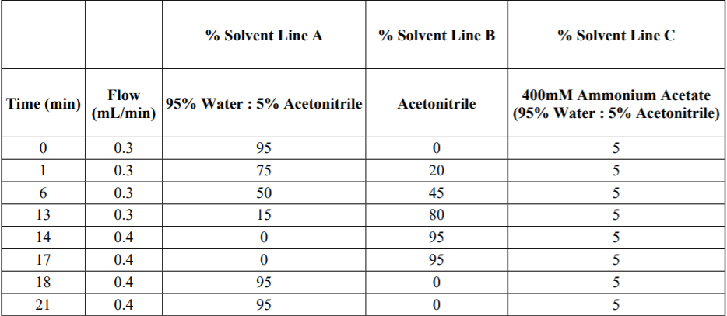
ASTM Standards – Analysis
Parts-per-trillion (ppt) analyte calibration range
21-minute run time
Ternary LC gradient

Slide 9
Lab Consumables
Lab consumable = lab supply that is considered one-time use, disposable, and inexpensive
Lab consumables in Region 5 lab PFAS methods:
Polypropylene sampling containers (15 mL and 50 mL conical centrifuge tubes)
Used also for reagent storage and standard preparation/storage
2 mL amber glass instrument vials (i.e. autosampler vials)
Polyethylene screw caps for 2 mL instrument vials
Polypropylene pipette tips (200 µL, 1 mL, 10 mL)
Polypropylene filtration disks (with 0.2 µm GHP membrane)

Slide 10
Erratic Lab Consumables Contamination
In July 2020, erratic PFAS contamination was discovered while processing a data set
Contamination varied in frequency, concentration, and affected PFAS target analytes
Such contamination caused the data set to be of unknown quality
All PFAS preparation/analysis ceased in the lab until the root cause of the contamination could be determined and corrected
After 4 months of investigation, the following lab consumables used for PFAS were found to erratically contain PFAS:
2 mL amber glass instrument vials (i.e. autosampler vials)
15 mL and 50 mL polypropylene conical centrifuge tubes (used for field sampling, reagent storage, and standard preparation/storage)
10 mL polypropylene pipette tips

Slide 11
Erratic Lab Consumables Contamination
Several brands, part numbers, and lots of affected consumables were extensively tested
Other brands and part numbers contained erratic PFAS contamination as well
Determined in-house self-certification of lots not feasible with limited staff/resources
Short-term solution: all PFAS field samples required to be collected, prepared, analyzed, and reported in triplicate
Allows for easy identification of false positives or biased-high results
“T” flag created to notify data users of potential false positives/biased-high results in data reports
Provides needed assurance to data users that the reported PFAS results are both precise and accurate

Slide 12
PFAS Contamination Data
98 aqueous field samples (236 in triplicate) have been prepared/analyzed since triplicate requirement enacted in November 2020
Method blanks, reporting limit checks, blank spikes, and triplicate field data all monitored for erratic contamination
2 method blanks, 2 reporting limit checks, and 2 blank spikes required for each batch of 20 (including triplicates) field samples
7,776 data points collected and evaluated
Contamination is determined using percent difference between the 3 replicates
± 30% difference is limit used to determine if result is a false positive or biased high

Slide 13
PFAS Contamination Data
Example of False Positive Result
PFOS in field sample 2102012-02 was flagged “T” in the data report to notify the client that the data point is likely a false positive
 |  | ≥ Reported RL |  | > ± 30% Difference (D) Limit
Sample ID | Analyte | Reported Result (ppt) | Reported RL (ppt) | %D -02 vs. -02RE1 | %D -02 vs. -02RE2 | %D -02RE1 vs. -02RE2
2102012-02 | PFOS | 28.9 | 11.1 | 826 | 820 | -0.64
2102012-02RE1 | PFOS | 3.12 | 10.3
2102012-02RE2 | PFOS | 3.14 | 10.1

Slide 14
PFAS Contamination Data

Slide 15
PFAS Contamination Data
129 contaminated data points

Slide 16
PFAS Contamination Data
20 highest contaminated data points

Slide 17
PFAS Contamination Data – Summary
Additional statistics:
88% of Region 5 lab PFAS method target analytes affected by continued erratic contamination
67% of contaminated data points at or near method reporting limits
On average, 2% of data points from each data set impacted by contamination
Caution should still be taken by data users when evaluating data variability in low-level results in terms of project decision making as replicate PFAS samples are co-located
Long-term solution: consumable vendors provide certified, trace-level (low ppt) PFAS-free products

Slide 18
Considerations When Requesting PFAS Analysis
What analytical method does the lab run?
 | EPA Method 533 | EPA Method 537.1 | ASTM Standard D7979 | EPA Method 8327
Lowest Target Analyte Calibration Range: | 0.5 - 25 ppb (on-column) | 0.5 - 25 ppb* (on-column) | 5 - 200 ppt (on-column) | 5 - 200 ppt (on-column)
Lowest Demonstrated Reporting Limit: | 10 ppt | 16 ppt | 10 ppt | 10 ppt
Initial Sample Volume: | 250 mL | 250 mL | 5 mL | 5 mL
Final Sample Volume (for Analysis): | 1 mL | 1 mL | 10 mL | 10 mL
*not published, assumed

Slide 19
Considerations When Requesting PFAS Analysis
What analytical method does the lab run?
If the method calibrates PFAS analytes in the ppt-range (on-column), it is strongly recommended to request triplicate sampling, preparation, analysis, and reporting for each sampling location
E.g. ASTM Standards D7979 and EPA Method 8327
If the method calibrates PFAS analytes in the ppb-range (on-column), the presented data suggests that the currently observed contamination in lab consumables may not impact these methods
E.g. EPA Methods 533 and 537.1 (providing the analyte calibration range or method RLs are not modified to be lower)
Also note that consumables used for these methods may differ from those used in D7979 or 8327

Slide 20
Considerations When Requesting PFAS Analysis
Why not just always use EPA Methods 533 or 537.1?
These are drinking water methods that were only validated by the EPA to be used for drinking water matrices
ASTM Standard D7979 and EPA Method 8327 were validated to be used for several aqueous matrices including surface water, groundwater, and wastewater (influent and effluent)
These direct injection methods also have significantly higher sample throughput rates, even when preparing samples in triplicate, than the labor-intensive drinking water methods
Once consumable vendors begin providing certified, trace-level (low ppt) PFAS-free products, triplicate analysis will no longer be necessary

Slide 21
Contact Information
Larry Zintek
zintek.lawrence@epa.gov
(312) 886-2925
Danielle Kleinmaier
kleinmaier.danielle@epa.gov
(312) 353-9771

